Slide 1
Cooperating Organization Partnership
Your Name
Title
chair@hobyohiosouth.org 740-500-HOBY
Notes:
Notes: Italics indicates instruction to presenter. Regular font indicates scripted text for you, but feel free to elaborate.
Timing: this presentation should take about 20 minutes. 6 minutes for the video plus 1 minute per content slide = 11 minutes, for a total of 17 minutes. You may want to practice to make sure you hit this timing. Then there should be time for 10+ minutes of Q&A.
Fill in the light blue items on the title slide.

Slide 2
Agenda
HOBY Video
HOBY Basics
HOBY Ohio South
How You Can Help
Questions
Notes:
Introduce yourself – name, where you are from, HOBY title and site, alumni year if applicable, how many years you have been involved with HOBY, why you volunteer for HOBY in 10 words or less, what you do in your real life.
Ask if there are any HOBY alums or volunteers present. If so, recognize them with a round of applause!

Slide 3
My HOBY Story
Notes:
Go into a bit more detail about how you became involved in HOBY and what it means to you. Focus on the mission and values of HOBY through your personal experience.

Slide 4
HOBY Video and Basics

Slide 5
HOBY: Inspiring Change, Changing Lives
Channel:
https://www.youtube.com/user/hoby
Video:
https://www.youtube.com/watch?v=YkFt5Wow-fE
Notes:
Thank the group for the opportunity to give a presentation about HOBY. Show the video at this link – https://www.youtube.com/watch?v=YkFt5Wow-fE
- 6 minutes.

Slide 6
HOBY Basics
HOBY is an “apolitical, all-inclusive professional youth leadership organization.”
Vision: To motivate and empower individuals to make a positive difference within our global society, through understanding and action, based on effective and compassionate leadership.
Mission: To inspire and develop our global community of youth and volunteers to a life dedicated to leadership, service and innovation.
Core Values: Volunteerism, Integrity, Excellence, Diversity, Community Partnership
Notes:
Apolitical – Not interested in or involved in politics
Non-religious – not spiritual or religious
Inclusive – covering or including everything; open to everyone
Professional - Having and showing the skill of advanced learning and diplomacy; a person who is an expert at his/her work.
UPDATED in 2014 - Program Participant and Volunteer Non-discrimination Policy
HOBY complies with all applicable anti-discrimination laws and does not illegally discriminate against, or give preferential treatment to any individual or group on the basis of age, race, gender, color, economic status, ethnicity, linguistic heritage, cultural background, national origin, ancestry, physical or mental disability or ability, medical condition, religious creed, marital status, employment status, housing status, sexual orientation, gender identity or veterans status or any other characteristic or status or distinction that is protected by law in the selection of participants and volunteers for HOBY's youth leadership programs and services. HOBY is committed to providing a balanced, safe and educational environment for all participants and volunteers. HOBY firmly believes that everyone should be treated equally and fairly.
We understand that Phi Sigma Pi is also a gender-inclusive organization☺
We are happy to be exercising our value of community partnership by working with Phi Sigma Pi!

Slide 7
Get to Know HOBY Ohio South

Slide 8
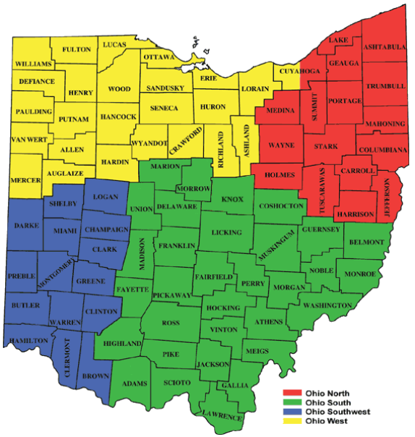
HOBY Programs
HOBY Ohio South
Leadership Seminar
June 8-11, 2017
Marietta College
CLEW
(Community Leadership Education Workshop)
May 13, 2017
Groveport Madison HS
Notes:
You may want to actually take them to each of these links and show them how to use the map. Click on map> zoom in to closest seminar location and click on pin> view pop-up window of site information and scroll down to website link> click on website link to get to seminar contact info page on HOBY website> click on a person to contact.

Slide 9
HOBY OHS Fast Facts
200 sophomores attend annually
70 volunteer staff
20+ year round volunteers
40+ years of HOBY in Ohio
Every ambassador challenged to commit 100 hours of community service

Slide 10
HOBY: Inspiring Change, Changing Lives
Video:
https://www.youtube.com/watch?v=BdiqnqWcSwQ
Notes:
Show the video at this link – https://www.youtube.com/watch?v=BdiqnqWcSwQ
- 3 minutes.

Slide 11
HOBY OHS Impact - 2017
How many students have attended HOBY Ohio South since 1986?
4,783
How many service hours were completed by 2016 HOBY OHS alumni?
3,270
Equal to 1.5 years of FT service
How many service hours have been completed by HOBY OHS alumni since 1999?
100,555
Equal to 48 years of FT service
Notes:
.

Slide 12
How You Can Help

Slide 13
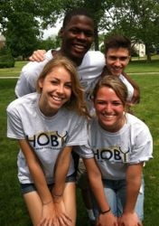
Sponsor a Student
Do the local High Schools surrounding your chapter participate in HOBY?
Does your High School Alma Mater participate in HOBY?
Know of a low income area school that could use some support?
Let’s find out if these schools send a student to HOBY and if not, your organization can sponsor a student(s). Ask your HOBY Contact to look it up!
Know a specific student (sibling, cousin, friend) who would benefit from a HOBY Program? Let’s get them registered!
Notes:
We always need sponsors to fund the participation of students from low-income schools or non-participating schools. Your organization can sponsor as many students as you would like! If you provide the sponsorship, we can find the student who needs it.
We also always need help recruiting students and calling schools to get students registered. We train you, give you a script, and assign you a short list of schools to call during school hours. You can help us a lot with just that one hour of time.

Slide 14
Sponsor a Student (cont.)
Amounts to sponsor a student to attend a HOBY program:
Leadership Seminar (LS) cost per student = $395
Leadership Seminar subsidized cost = $225
*HOBY volunteers fundraise to offer a reduced cost to one student from every high school in our area. This is to try to make HOBY accessible to as many students and communities as possible.
### Students Representing ### Ohio High Schools are registered today
### High Schools in region still not represented
Notes:
Fill in the blue numbers above to reflect current data. If you do not know, contact chair@hobyohiosouth.org

Slide 15
Donate Gifts in Kind (GIK)
Seminars always need donations of products:
Office Supplies
Drinks and Snacks
Gift cards for Walmart, Target, Sam’s Club, etc.
Supply Wish List is Available
Notes:
We can always use product donations of various things. Connect with your HOBY site to find out what products they need specifically and get their wish list. Then see which wishes your organization can fulfill. Has anyone here conducted a donation drive for HOBY or another organization?

Slide 16
Apply for a Volunteer Role
There are many positions! If you have a skill, talent, or just some time, we can use you!
See list of all volunteer descriptions: https://reg.hoby.org/HOBYVolunteerApplication/VolAppPositionsDescriptions.aspx
Not sure what to apply for? Choose “I don't know - please call me to discuss volunteer opportunities”.
Apply Here: https://reg.hoby.org/HOBYVolunteerApplication/ - the application only takes 5 minutes!
Notes:
Explore the volunteer descriptions and apply today!

Slide 17
More Volunteer Opportunities
Seminar Planning Committees – any age:
Recruitment – serve on a team to get students registered to attend the seminar.
Operations – serve on a team to ensure smooth logistics during the seminar.
Program – serve on a team to organize and conduct the seminar event schedule.
Finance – serve on a team to fundraise and gather products and supplies needed.
Notes:
Learn practical project planning and management skills while volunteering for HOBY on one of these teams!

Slide 18
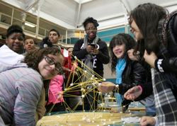
Hold a Community Leadership Workshop (CLeW)
Work with your HOBY site to do a CLeW for HS Freshmen
1 day leadership training program
host on campus
< $500 needed to hold a CLeW
8 weeks of planning time
Resources available from HOBY
Notes:
This is an excellent hands-on program/service project for your organization to do with HOBY! We have resources available to help you plan the day and get started. We can guide you through the entire planning and implementation process. This is an excellent way to connect with the next generation of leaders☺ And it’s fun too!

Slide 19
General Fundraising
You can always do a general fundraiser of your choosing to benefit the HOBY program closest to your chapter!
Contact us to learn more!

Slide 20
Q&A
Name, Title
chair@hobyohiosouth.org 740-500-HOBY
Notes:
Fill in presenter name, title, e-mail and phone number.
Thank the group for their time and attention and partnership with HOBY. Then followed by Q&A and discussion.
If you get a question that you do not know the answer to, simply say that you will find out the answer. E-mail the question copying the person who needs the answer to chair@hobyohiosouth.org
Optional: You can hand out a sample GIK wish list, or actual GIK wish lists for all the sites in the geographic area represented at the regional conference.
If there are CLeWs happening this spring in the area, you can give contact info and invite members to come volunteer for or observe the CLeW to learn more about them.
You can look up schools surrounding the organization and see if they participate in HOBY and share that info.
Questions about this presentation can be directed to Vicki Ferrence Ray at ferrencerayv@hoby.org.
Thank you! We hope that the time you spent today to give this presentation will be well worth it!

